Slide 1


CHAPTER 2
What is Money ?

Slide 2
“Money is a guarantee that we may have what we want in the future. Though we need
nothing at the moment, it ensures the possibility of satisfying a new desire when it arises.”
Aristotle

Slide 3
Definition of Money
Money is like a social contract that allows us to make exchanges without having to rely on bartering or finding someone who specifically wants what we have to offer. If a group of people started accepting chocolate as payment for most goods and services, chocolate would become money (although, since it would melt in some parts of the world, we might consider it bad money).

Slide 4
“ Money performs but a momentary function in an
exchange; and when the transaction is finally closed, it will
always be found that one kind of commodity has been exchanged for another. ”
Jean-Baptiste

Slide 5
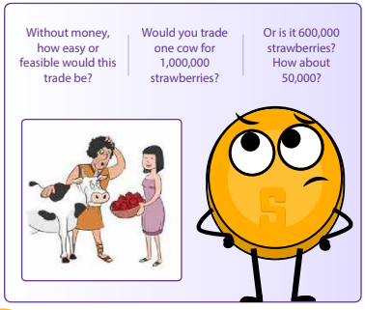

Slide 6
Functions of Money
When it comes to buying and selling goods and services, money is the key player.
Money serves several important functions in the world, like:
Store Of Value
Money should maintain its value over time, making it useful as a method to save and invest the value of human labor. This lets people use money to plan for the future and borrow and lend money. So, the next time you’re saving up for something special, remember that money is more than just a way to pay for
things – it’s a tool to help you plan and invest in your future.

Slide 7
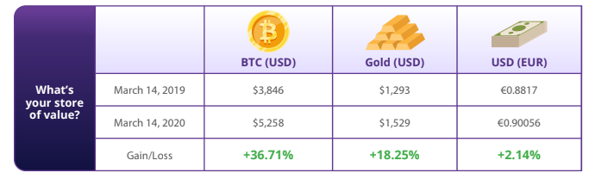

Slide 8
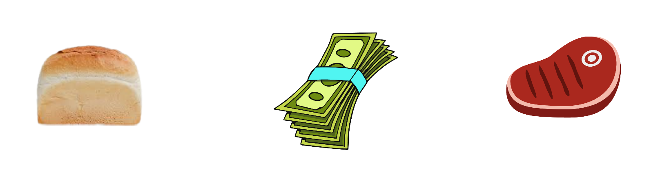
2. Medium Of Exchange
With money, you don’t have to find someone who wants exactly what you have to trade. Instead, you can use money to buy and sell anything you want. This makes trading and commerce much more convenient and efficient.

Slide 9
3. Unit of Account
Money provides a universal standard of value that allows people to express and compare the price of different goods and services. This allows for a more efficient and transparent market, where people can make informed decisions about what to buy and sell.

Slide 10
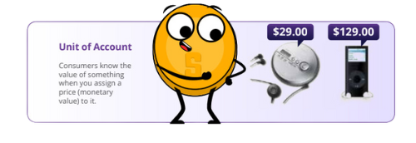

Slide 11
Properties of Money
Over time, people have ultimately realized that money must possess certain qualities to be effective as a medium of exchange. These characteristics include durability, divisibility, portability, acceptability, scarcity, and fungibility.

Slide 12
Durability
Refers to the ability of money to resist physical deterioration and last over time. This ensures that money can circulate in the economy in an acceptable and recognizable state. Gold is a durable material that can withstand wear and tear, making it a good representation of the durability characteristic of money.
Durability
Refers to the ability of money to be divided into smaller units so that people can use it to make purchases of varying amounts. Paper bills can be easily divided into smaller denominations, making them a good representation of the divisibility characteristic of money.

Slide 13
Durability
Refers to the ease with which money can be transported and carried around. This allows people to use money to buy and sell goods and services without
difficulty. Credit cards are portable, as they can easily be carried in a wallet or purse, making them a good representation of the portability characteristic of money.
Acceptability
Refers to the widespread acceptance of money as a form of payment
so that people can use it to buy and sell goods and services with confidence. The US dollar is widely accepted as a form of payment, making it a good representation of the acceptability characteristic of money.

Slide 14
Scarcity
Refers to the limited supply of money, which helps maintain its value and
prevent us from having to spend more money to buy the same amount of goods. Collectible stamps, especially rare and valuable ones, can be a good form of money because they are scarce and can appreciate in value over time. Stamp collectors often use their stamps as a way to invest their wealth
and to diversify their portfolio.
Acceptability
Refers to the interchangeability of money so that one unit of money is
equivalent to another unit of the same value. Money should be uniform. Copper coins are uniform in size and weight, making them a good representation of the uniformity characteristic of money. One cent is always
one cent.

Slide 15
Scarcity
Refers to the limited supply of money, which helps maintain its value and
prevent us from having to spend more money to buy the same amount of goods. Collectible stamps, especially rare and valuable ones, can be a good form of money because they are scarce and can appreciate in value over time. Stamp collectors often use their stamps as a way to invest their wealth
and to diversify their portfolio.
Acceptability
Refers to the interchangeability of money so that one unit of money is
equivalent to another unit of the same value. Money should be uniform. Copper coins are uniform in size and weight, making them a good representation of the uniformity characteristic of money. One cent is always
one cent.

Slide 16
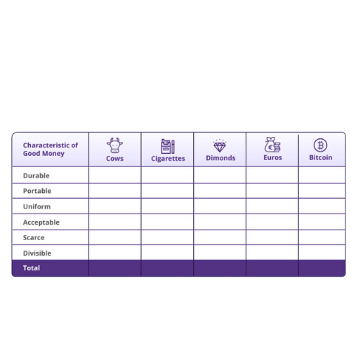

Slide 17
2.4 Types of Money
Money can be divided into two main categories: physical and digital.
Fiat money, which is the paper bills and coins issued by governments and accepted as a medium of exchange.
Representative money, which represents a claim on a physical commodity.
Commodity money, which is a physical object that has intrinsic value and is widely accepted as a medium of exchange. For example, gold and silver.

Slide 18
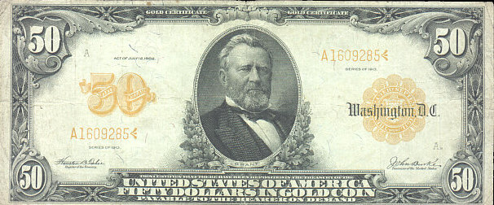
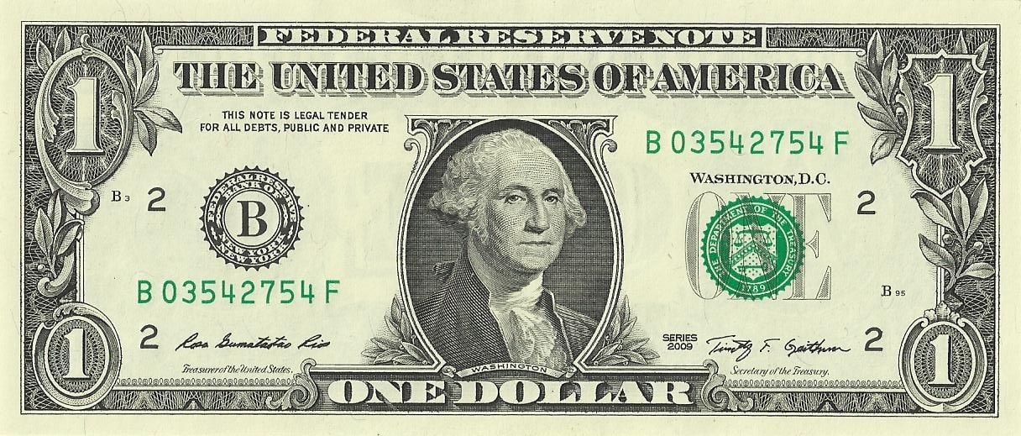
Today, Federal Reserve
notes are fiat money,
decreed by the federal
government to be an
acceptable way to pay debts.
Representative
money like this silver
certificate could be
exchanged for silver.

Slide 19
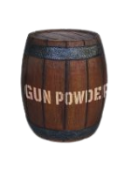
Objects like this gun
powder once served
as commodity
money.

Slide 20
Digital currencies,
on the other hand, can be used for online transactions and include electronic currencies, stablecoins, and bitcoin.
Electronic currencies are digital versions of regular money, like
dollars or euros, and can be used to buy and sell things online via
digital payment rails.
Payment rails are the infrastructure enabling the movement of electronic
currencies and other digital assets from one place to another. However, in
the traditional financial system, there is always a middleman, such as a bank
or financial institution, that charges a fee and has the authority to accept,
cancel, revert, or delay transactions.

Slide 21
Stablecoins
Are digital currencies designed to maintain a stable value relative to an asset, like the U.S. dollar.
Cryptocurrencies
Are a type of digital currency. Some cryptocurrencies are decentralized and governed by rules, while others are centralized and controlled by a small group of people.

Slide 22
Ultimately, a currency that operates without intermediaries is more efficient and beneficial for society, as it
prevents a few individuals from controlling the money supply and concentrating their power.

Slide 23
2.5 The Psychology of Money: Scarcity, Time Preference, and Trade-offs
Imagine you are stranded in a desert and you only have one bottle of water left. You are thirsty and desperate for a drink, but you also know that you will need the water to survive until you can find more. This is a classic example of scarcity – you only have a limited amount of a resource (water) and you must
make a choice about how to use it. In this situation, you might decide to ration it and take small sips over a longer period of time to make it last as long as possible. Alternatively, you might decide to drink as much as you can in
one go, hoping that the burst of hydration will give you the energy you need to find more water.

Slide 24
Scarcity forces us to weigh the pros and cons of how we use our resources and make trade-offs.
Human-made scarcity, also known as centralized scarcity, includes things like limited edition designer bags, rare sports cards, and numbered art pieces. These can be easily replicated or counterfeited.
Natural scarcity, also known as decentralized scarcity, includes things like salt, shells, and precious metals like gold. These are harder to replicate or counterfeit.
The main difference between the two is control.

Slide 25
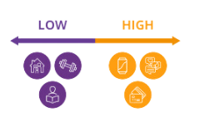
Time preference refers to the idea that people generally prefer to have something NOW rather than LATER.

Slide 26
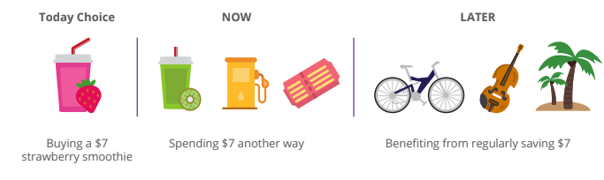
Opportunity cost refers to the value of the next best alternative that you give up when you make a decision. Every decision involves trade-offs.

Slide 27
In the desert example, the opportunity cost of drinking all of the water right away is the survival benefits you would have gained from rationing the water and using it over a longer period of time.

